Slide 1

CSE 350 Digital Electronics and Pulse Techniques
Analog to Digital Converter (ADC)
Course Instructor: Shomen Kundu (SDU)
Mail: shomen.kundu@bracu.ac.bd
Desk: 4N166

Slide 2
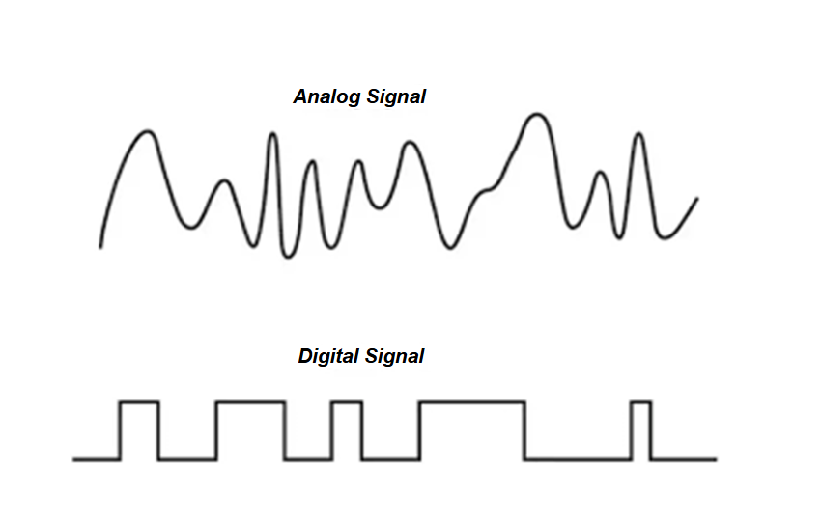
Analog to Digital Converter (ADC)
Signal can be classified into two broad categories.
Analog Signal ii. Digital Signal

Slide 3
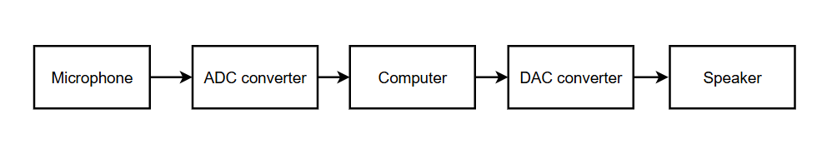
Analog to Digital Converter (ADC)
Physical world’s information are mostly analog. Analog means data could take
any real value at each instant of time.
In order to store/process we use digital data in our computers and microprocessor
Digital data means binary bit of strings.

Slide 4
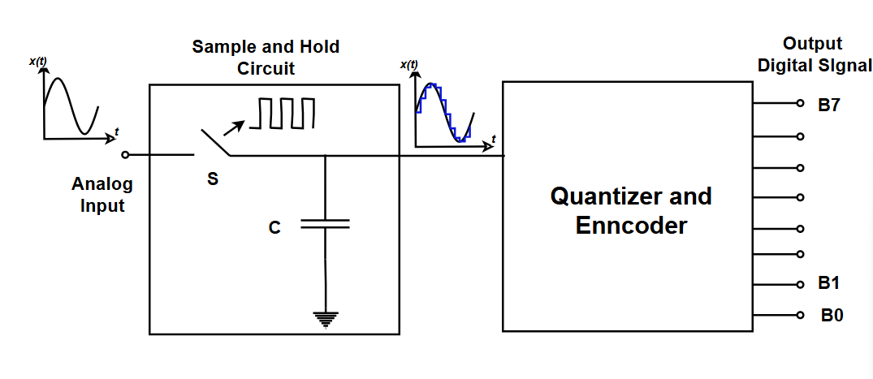
A/D conversion process

Slide 5
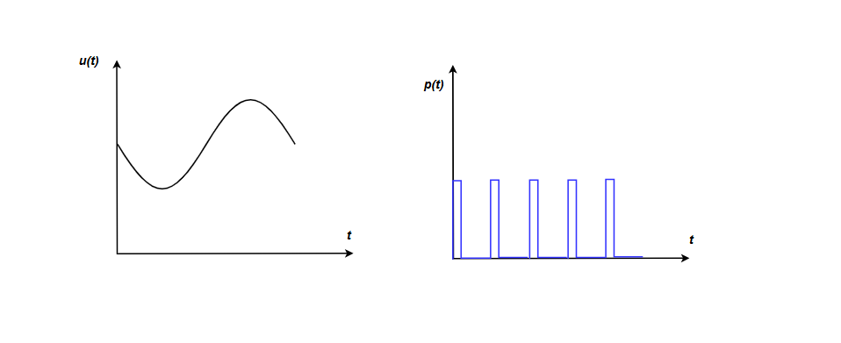
Sample and Hold Circuit

Slide 6
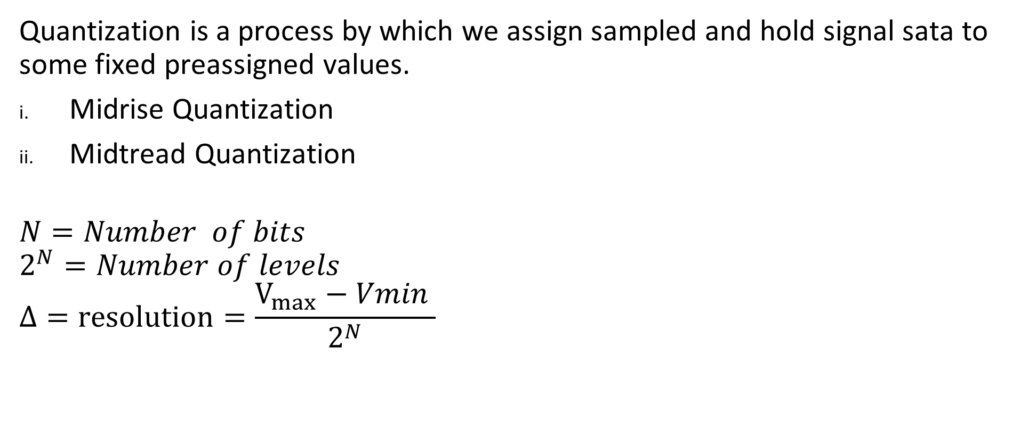
Quantization:
Quantization is a process by which we assign sampled and hold signal sata to some fixed preassigned values.
Midrise Quantization
Midtread Quantization
$$N=Number of bits$$
$$2^{N}=Number of levels$$
$$Δ=resolution=\frac{V_{max}−Vmin }{2^{N}}$$

Slide 7
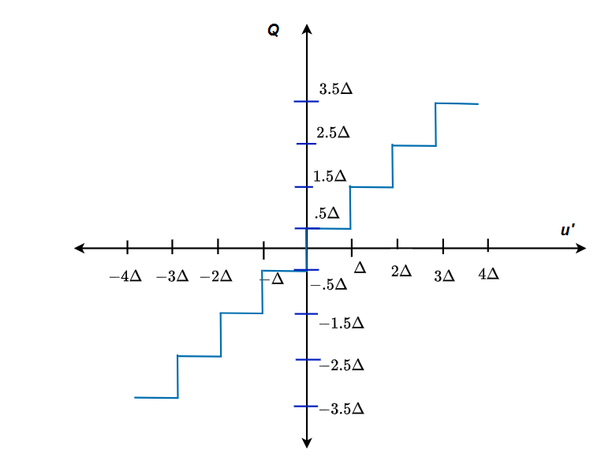
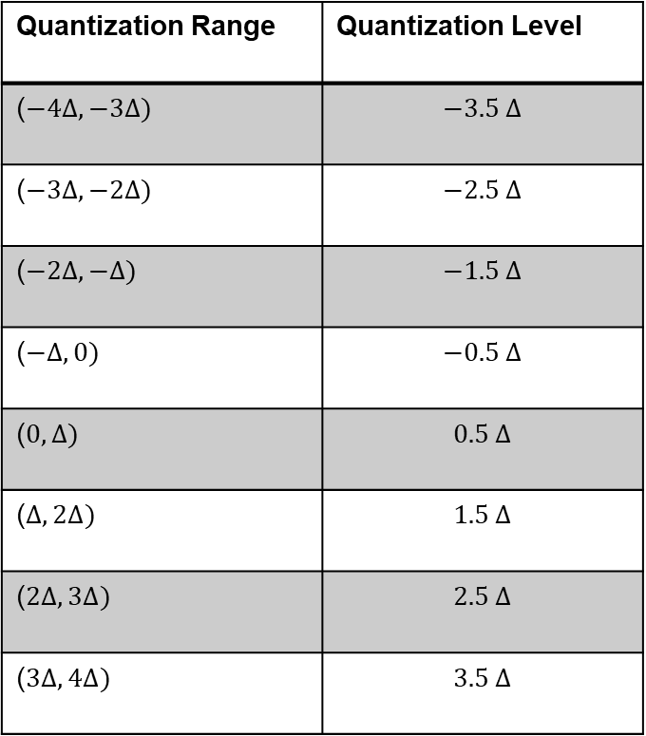
Midrise Quantization:
Quantization Range | Quantization Level
($−4∆, −3∆)$ | $$−3.5 ∆$$
($−3∆, −2∆)$ | $$−2.5 ∆$$
($−2∆, −∆)$ | $$−1.5 ∆$$
($−∆, 0)$ | $$−0.5 ∆$$
($0, ∆)$ | $$0.5 ∆$$
($∆, 2∆)$ | $$1.5 ∆$$
($2∆, 3∆)$ | $$2.5 ∆$$
($3∆, 4∆)$ | $$3.5 ∆$$

Slide 8
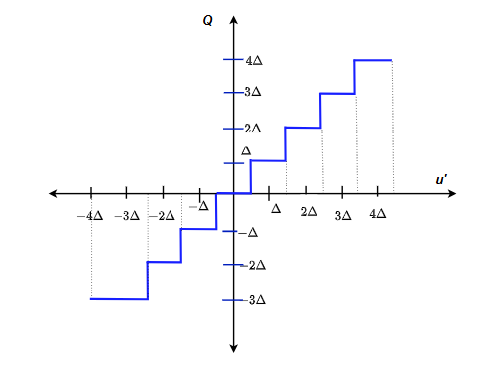
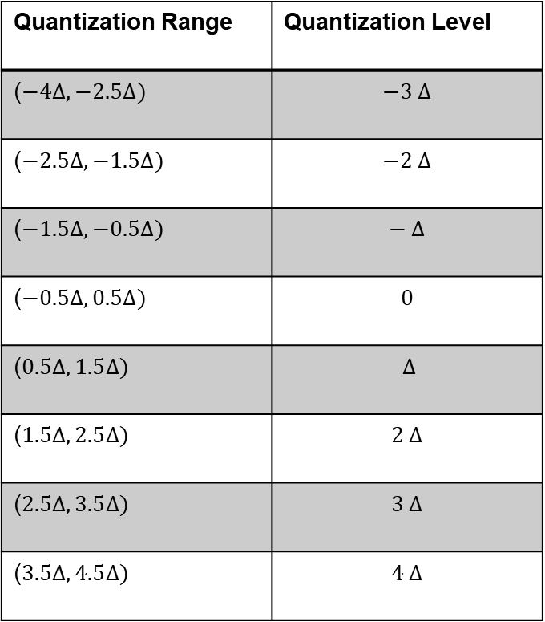
Mid tread Quantization ( Not symmetrical and Equally Spaced)
Quantization Range | Quantization Level
($−4∆, −2.5∆)$ | $$−3 ∆$$
($−2.5∆, −1.5∆)$ | $$−2 ∆$$
($−1.5∆, −0.5∆)$ | $$− ∆$$
($−0.5∆, 0.5Δ)$ | $$0$$
($0.5Δ, 1.5∆)$ | $$∆$$
($1.5∆, 2.5∆)$ | $$2 ∆$$
($2.5∆, 3.5∆)$ | $$3 ∆$$
($3.5∆, 4.5∆)$ | $$4 ∆$$

Slide 9

Encoding
We can choose binary values for each of the level.
$Number of bits=Ceil (log2\left( Number of levels \right))$
Assign lower Q level to 0
Then increase one for each next level

Slide 10
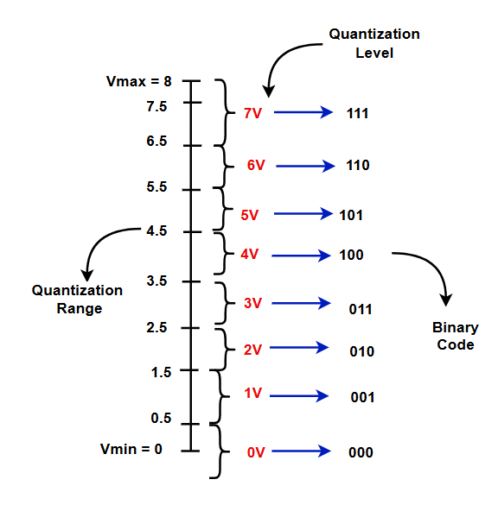
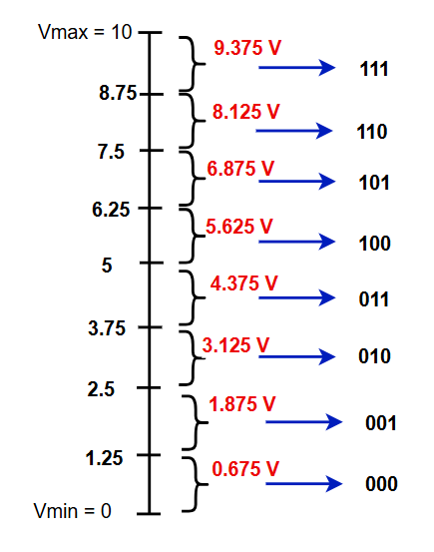
Quantization Range, Level, code
Ex: Identify which one is Mid rise and Mid tread.

Slide 11
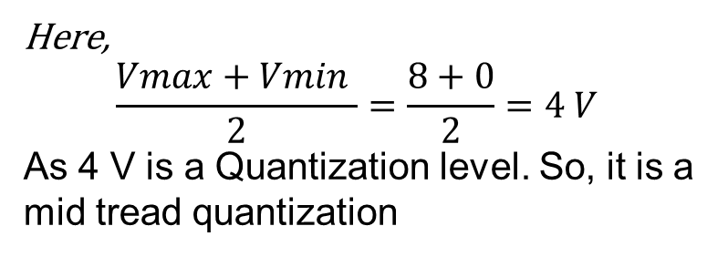
Quantization Range, Level, code
Here,
$$\frac{Vmax+Vmin }{2}=\frac{8+0}{2}=4 V$$
As 4 V is a Quantization level. So, it is a mid tread quantization

Slide 12
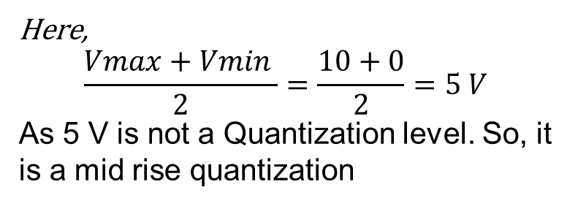
Quantization Range, Level, code
Ex: Identify which one is Mid rise and Mid tread.
Here,
$$\frac{Vmax+Vmin }{2}=\frac{10+0}{2}=5 V$$
As 5 V is not a Quantization level. So, it is a mid rise quantization

Slide 13
Flash A/D converter
Features of the Flash A/D converter
This converter is very fast.
It requires one clock cycle to convert the analog to digital data.
It requires a lot components.

Slide 14
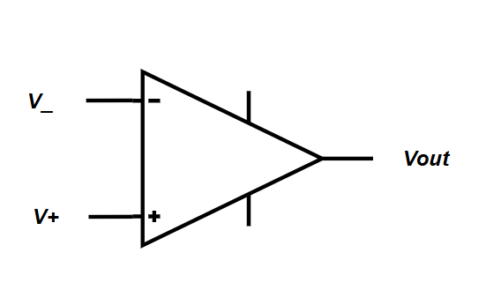

Op-Amp
For open loop configuration
$$If V_{+}>V_{−} , V_{out}=High (logic 1 )$$
$$If V_{+}<V_{−} , V_{out}=Low (logic 0 )$$

Slide 15
Flash ADC design
Suppose you have a signal with Vmax = 10 V and Vmin = 0V. Design a simple flash ADC converter. Use 3 bits for designing.

Slide 16
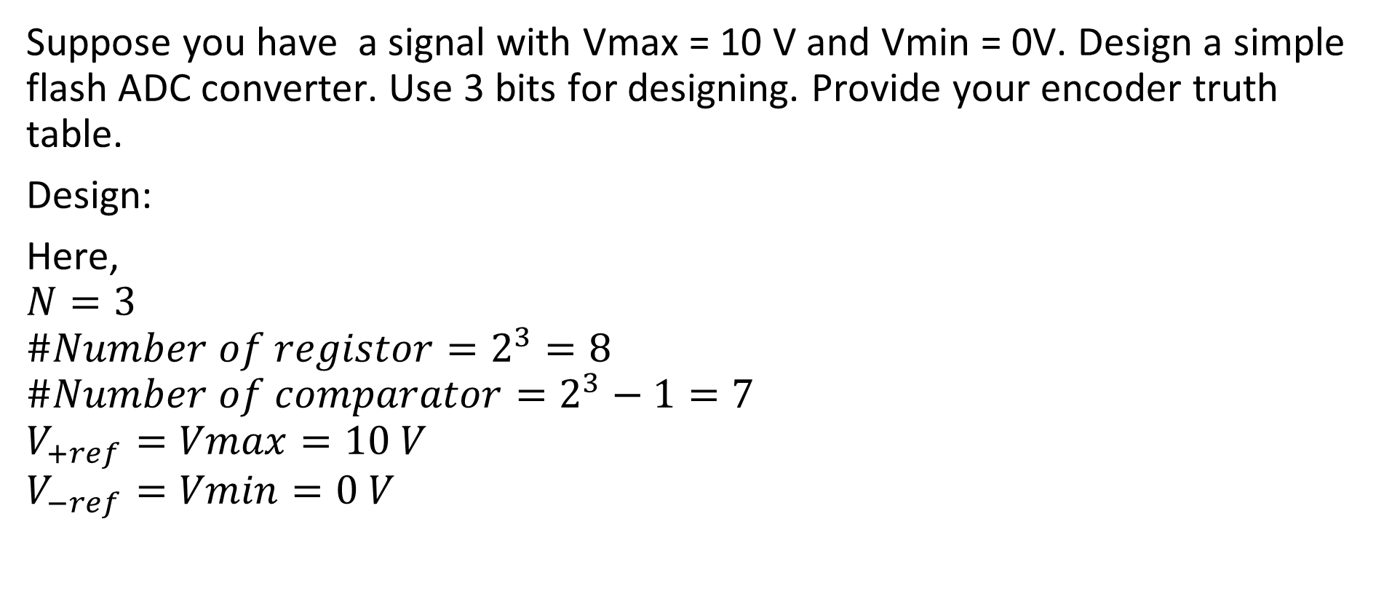
Flash ADC design
Suppose you have a signal with Vmax = 10 V and Vmin = 0V. Design a simple flash ADC converter. Use 3 bits for designing. Provide your encoder truth table.
Design:
Here,
$$N=3$$
$$\#Number of registor=2^{3}=8$$
$$\#Number of comparator=2^{3}−1=7$$
$$V_{+ref}=Vmax=10 V$$
$$V_{−ref}=Vmin=0 V$$

Slide 17
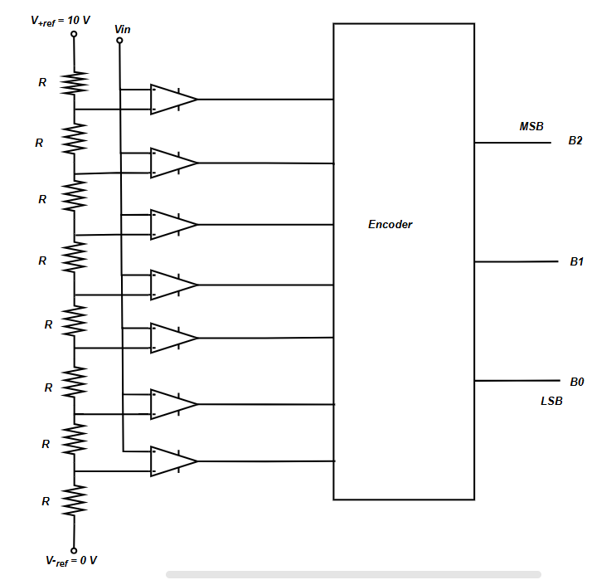
Circuit
The following is the Circuit of a 3 bits Flash ADC,
V+ of the comparator is connected to the input.

Slide 18
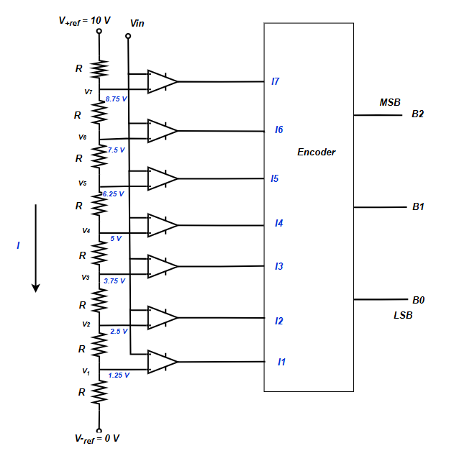
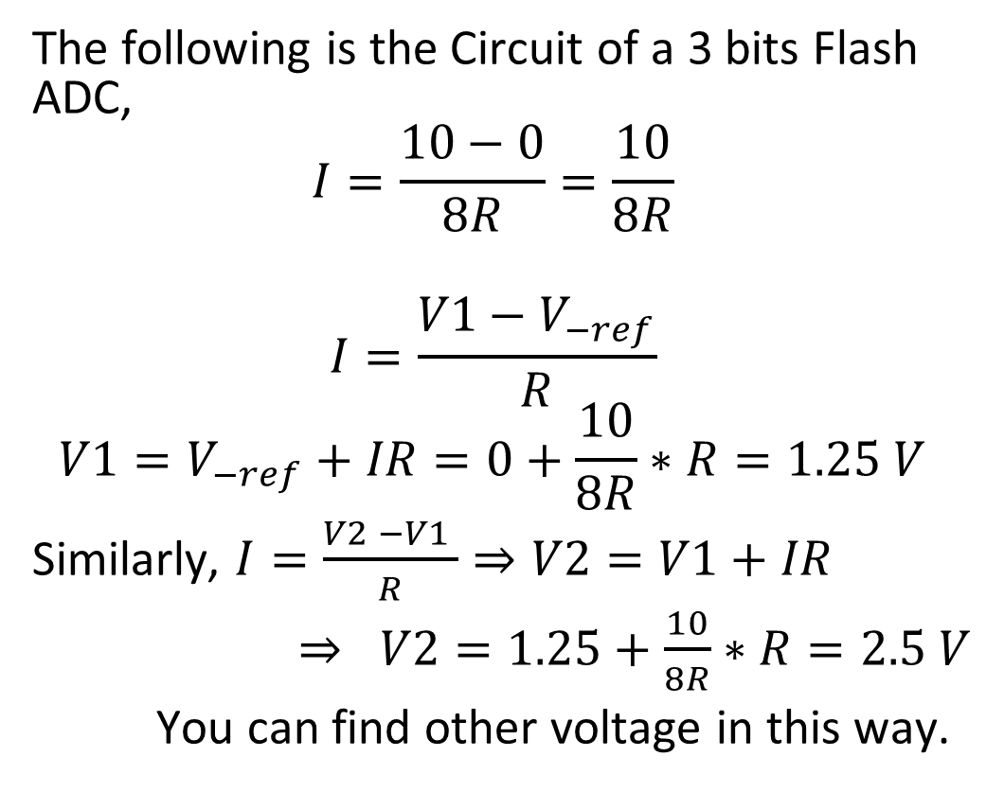
Circuit Analysis
The following is the Circuit of a 3 bits Flash ADC,
$$I=\frac{10−0}{8R}=\frac{10}{8R}$$
$$I=\frac{V1−V_{−ref}}{R}$$
$$V1=V_{−ref}+IR=0+\frac{10}{8R}∗R=1.25 V$$
Similarly, $I=\frac{V2 −V1 }{R}⇒V2=V1+IR$
$⇒ V2=1.25+\frac{10}{8R}∗R=2.5 V$
You can find other voltage in this way.

Slide 19
Circuit Analysis
Summary table:
Q Range | Q level | I7I6I5I4I3I2I1 | Binary (B2B1B0)
0 - 1.25 | 0.675 | 000 000 0
1.25 - 2.5 | 1.875 | 000 000 1
2.5 - 3.75 | 3.125 | 000 001 1
3.75 – 5 | 4.375 | 000 011 1
5 – 6.25 | 5.625 | 000 111 1
6.25 – 7.5 | 6.875 | 001 111 1
7.5 – 8.75 | 8.125 | 011 111 1
8.75 - 10 | 9.375 | 111 111 1

Slide 20
Circuit Analysis
Encoder Truth Table:
( V+ of the comparator is connected to the Input )
Encoder can be implemented using
the combinational network.
I7I6I5I4I3I2I1 | Binary (B2B1B0)
000 000 0 | 000
000 000 1 | 001
000 001 1 | 010
000 011 1 | 011
000 111 1 | 100
001 111 1 | 101
011 111 1 | 110
111 111 1 | 111

Slide 21
Circuit Analysis
Encoder Truth Table:
( V- of the comparator is connected to the Input )
Encoder can be implemented using
the combinational network.
I7I6I5I4I3I2I1 | Binary (B2B1B0)
111 111 1 | 000
111 111 0 | 001
111 110 0 | 010
111 100 0 | 011
111 000 0 | 100
110 000 0 | 101
1 000 000 | 110
000 000 0 | 111

Slide 22
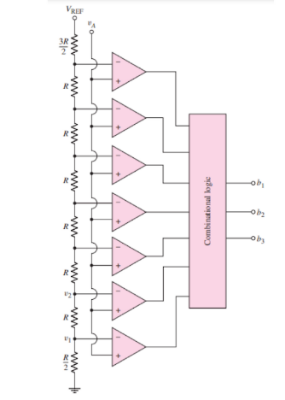
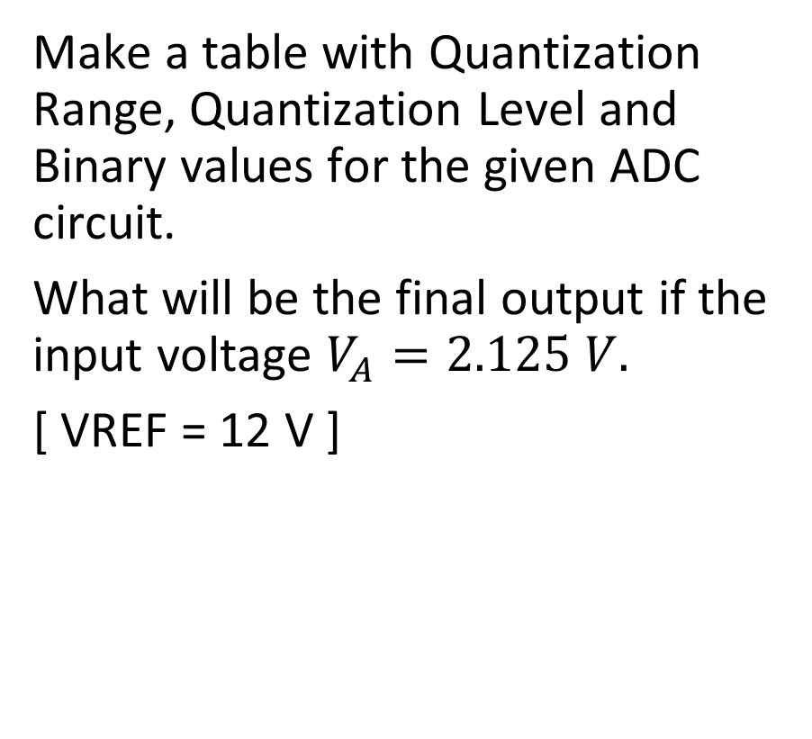
Problem:
Make a table with Quantization Range, Quantization Level and Binary values for the given ADC circuit.
What will be the final output if the input voltage $V_{A}=2.125 V.$
[ VREF = 12 V ]

